Slide 1
Miniclip
New Game Feature Analysis
10/04/2026
Senior Product Analyst · Prepared for: Interview · Prepared By: Olajide Badero

Slide 2
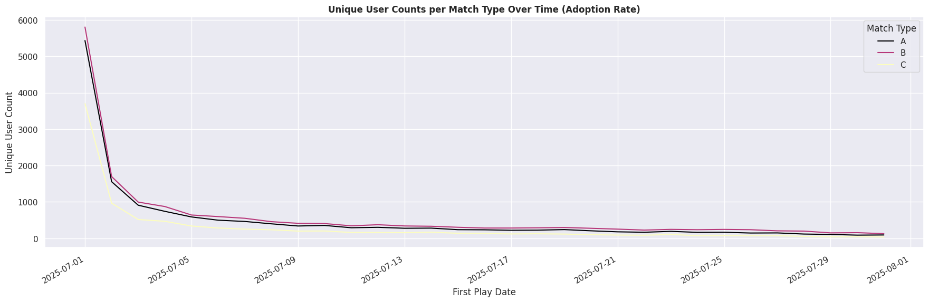
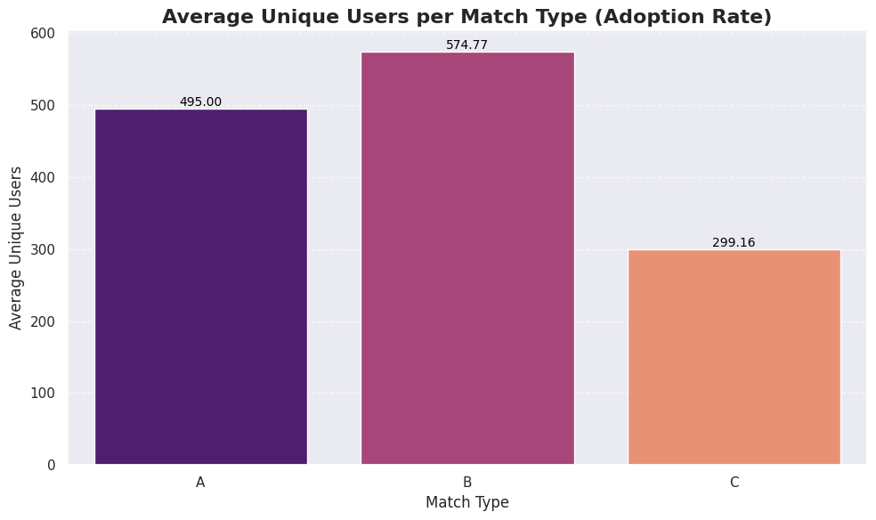
Feature Adoption
All match types experienced a strong launch spike driven by initial curiosity (~ 4980 users averagely), but over 70% of users dropped off within the first 2–3 days, indicating a significant on-boarding and early experience gap.
Match Type B consistently outperforms, suggesting stronger player appeal or design balance, while Match Type C underperforms from day one, pointing to a discoverability or positioning issue rather than just retention.
Match Type B leads with ~575 avg daily unique users, A at 495, and C at just 299 (roughly half of B.) Adoption stabilises after the first week with no re-engagement spikes, highlighting the absence of retention mechanics and long-term engagement drivers.

Slide 3
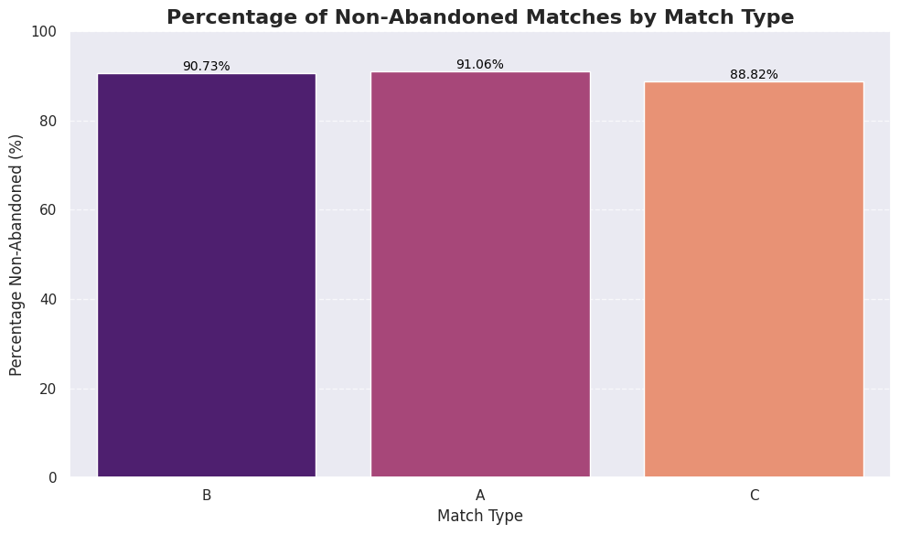
Feature Activation

Slide 4
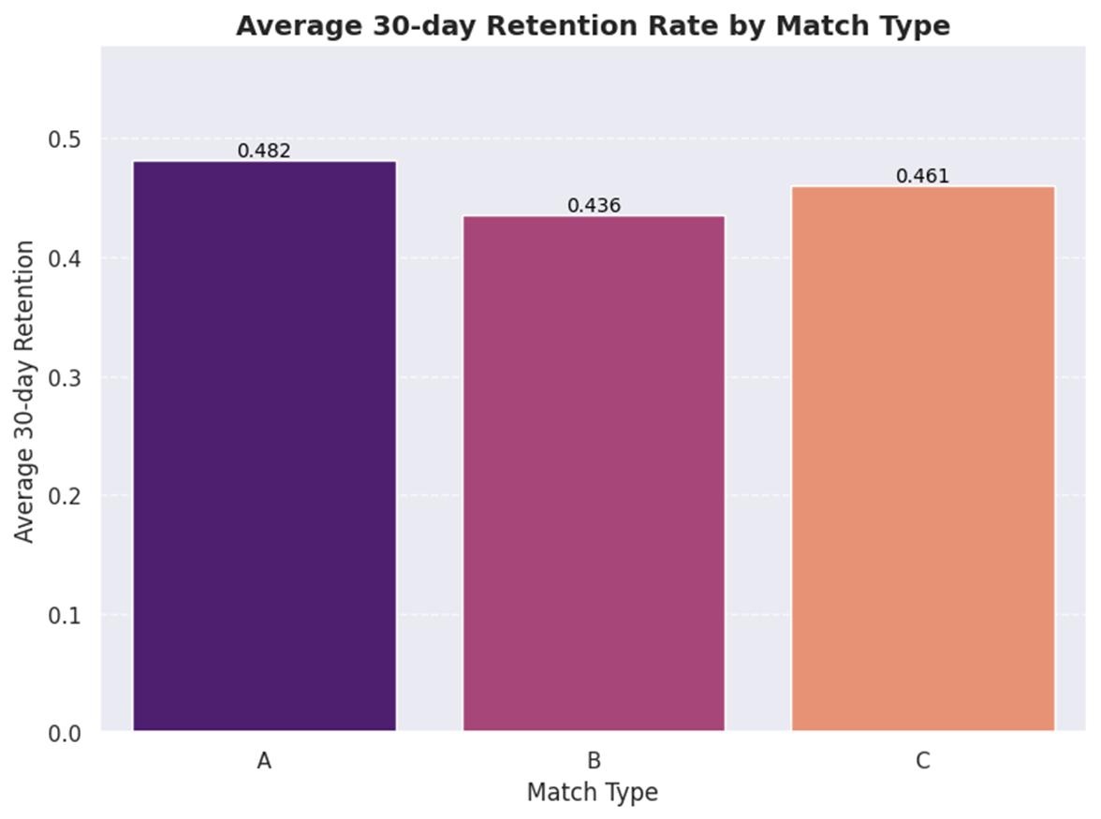
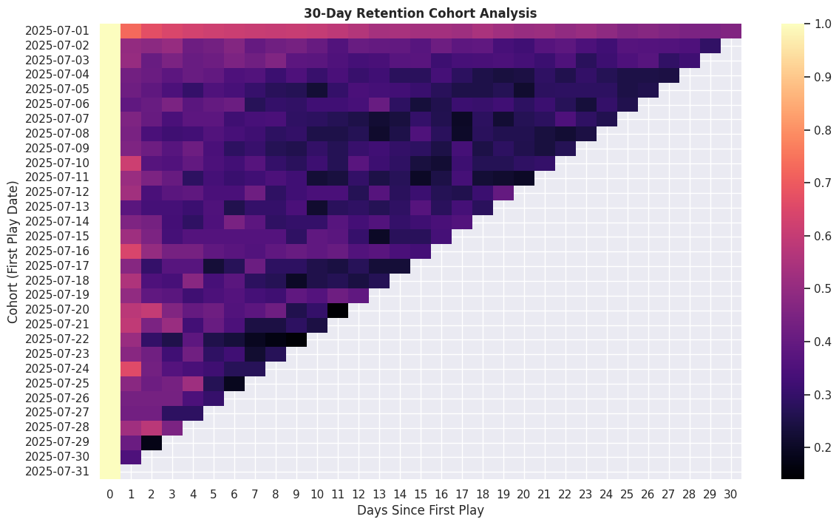
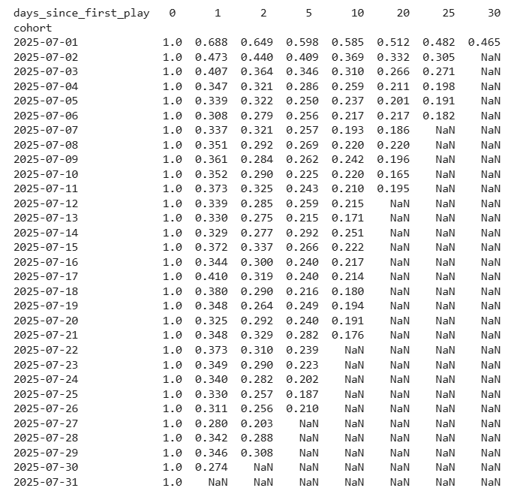
Feature 30-Day Retention
The feature shows a clear gap between acquisition and retention. Match Type B brings in the most users at around 575 daily, but retains the least at 43.6%. In contrast, Match Type A, with lower adoption, performs best on retention at 48.2%, suggesting a stronger gameplay loop. Match Type C sits in the middle, reinforcing that experience quality matters more than scale.
Retention drops sharply early on, with 60 to 70% of users churning within the first 48 hours. By Day 2, only about 25 to 30% of users remain, meaning most players leave before forming a habit.
However, those who stay beyond Day 5 become relatively stable, forming a small but loyal core. We also see that early cohorts retain much better, with nearly 46% still active by Day 30, while later cohorts drop off much faster.
Overall, the feature attracts users well but struggles to keep them, with Match Type A offering the clearest model for improving retention.

Slide 5
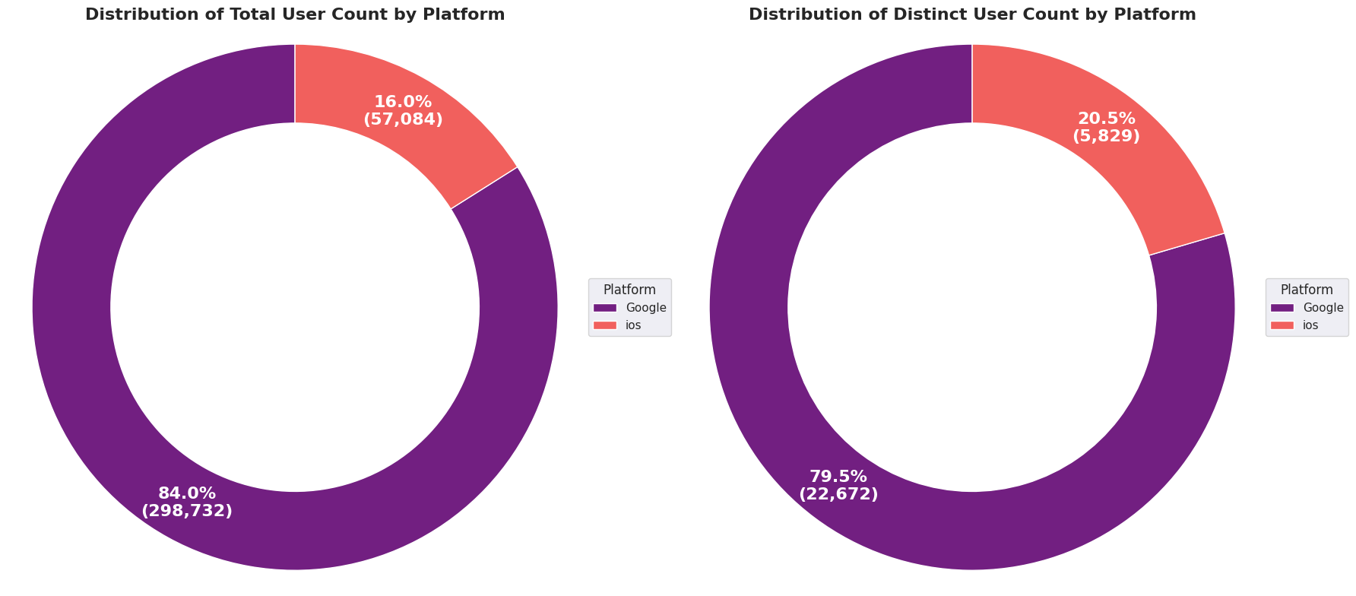
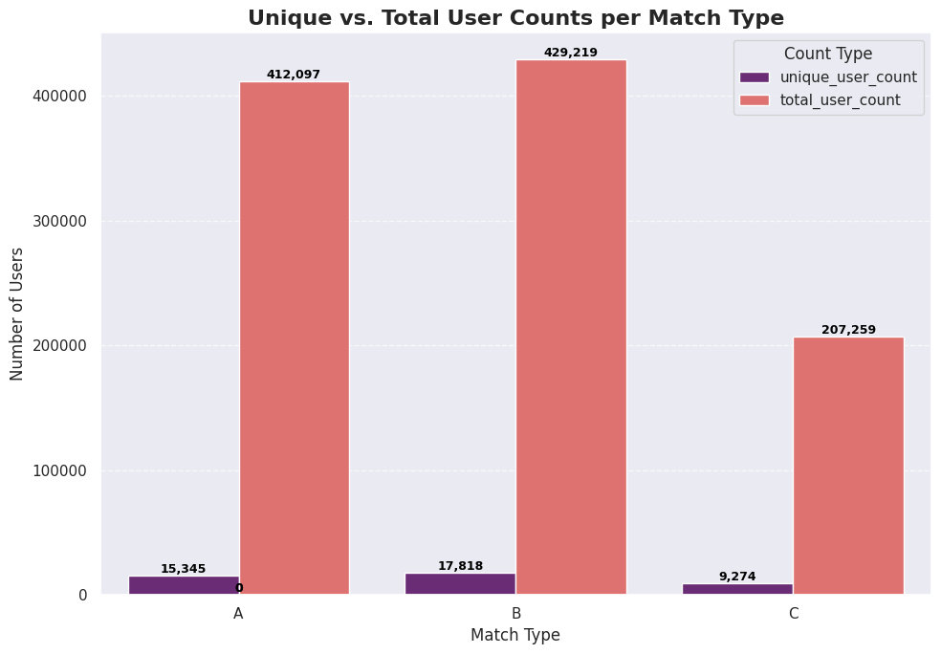
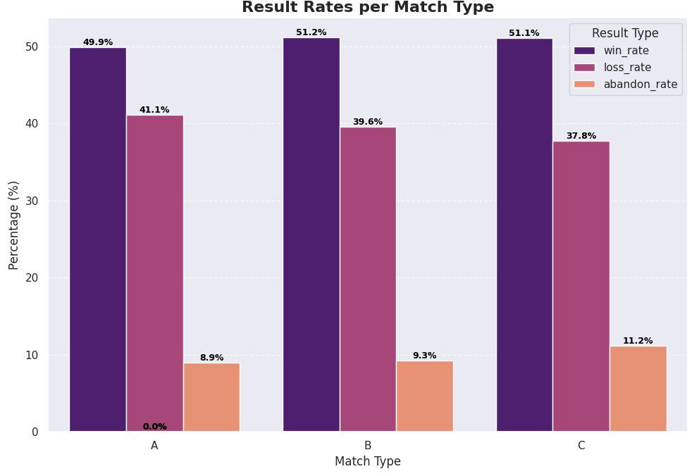
Feature Engagement
Most of the users play from Google platform compared to ios.
Across match types, Type B leads in total engagement, generating the highest number of matches, followed closely by Type A, while Type C significantly lags behind. However, volume alone doesn’t translate to quality. While win rates are relatively similar across all match types at around 50–51%, player behaviour tells a different story.
Type C stands out with the highest abandon rate at 11.2%, compared to 9.3% for B and 8.9% for A. This indicates that players are not just choosing other modes—they are actively dropping out mid-match, pointing to friction within the gameplay experience itself.
Overall, while Type B is the primary driver of engagement volume, Type A delivers more stable gameplay behaviour, and Type C shows clear signs of disengagement during play, suggesting issues with experience, balance, or usability rather than just low demand.

Slide 6
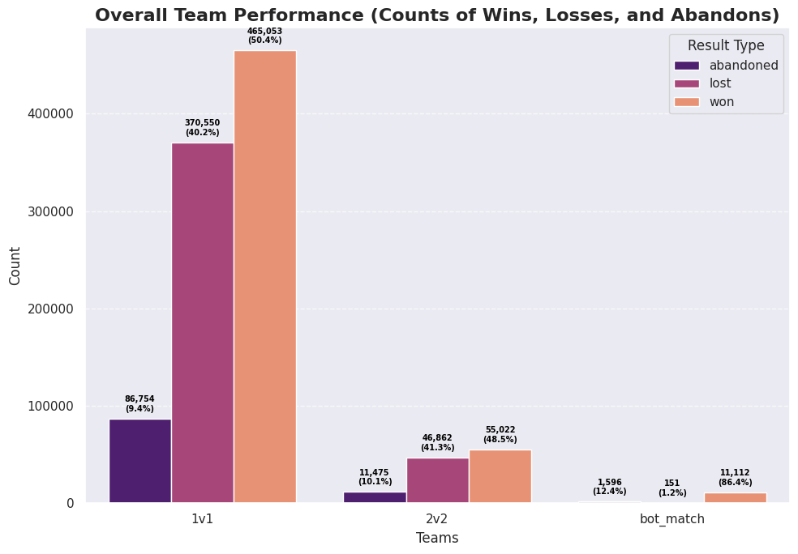
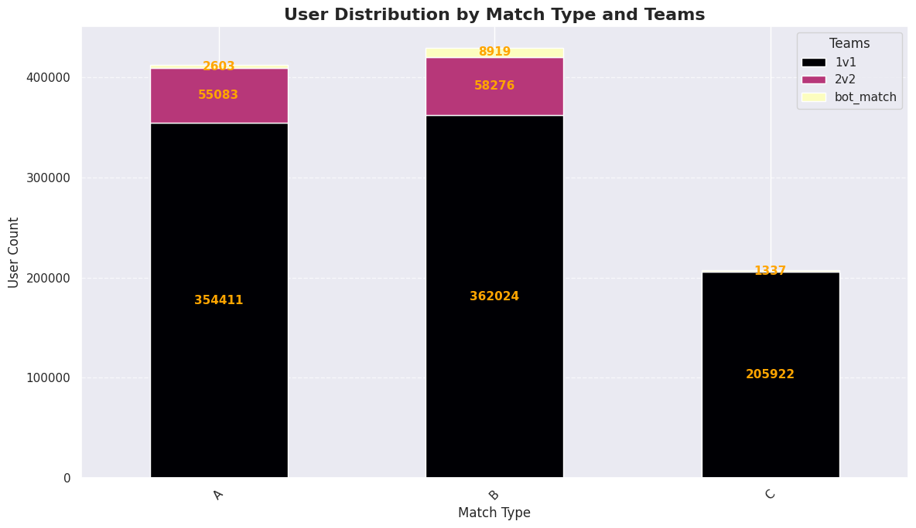
Team Engagement Performance
Engagement is heavily concentrated in 1v1 matches, which account for over 88% of total gameplay (922k out of ~1.05M matches), making it the dominant mode across all match types. Both Type A and B distribute some volume into 2v2 (~55k–58k matches each), but Type C shows zero participation in 2v2, indicating either a design misfit or lack of exposure for team-based play in this mode.
Bot matches behave as expected, with an 86.4% win rate, extremely low loss rate (~1.2%), and moderate abandon rate (12.4%). This confirms they are effectively positioned as confidence-building or on-boarding experiences, helping players secure easy wins.
Looking at player behaviour, abandon rates increase with complexity: 1v1: 9.4%, 2v2: 10.1%, Bot: 12.4%.
This suggests that multiplayer coordination and possibly low-stakes bot matches introduce more drop-off, either due to friction, lower engagement, or reduced perceived value.
Overall, while 1v1 is the clear engagement driver, the absence of 2v2 in Type C highlights a missed opportunity (or design limitation), and rising abandon rates in more complex modes point to potential gameplay or experience friction that could be optimised.

Slide 7
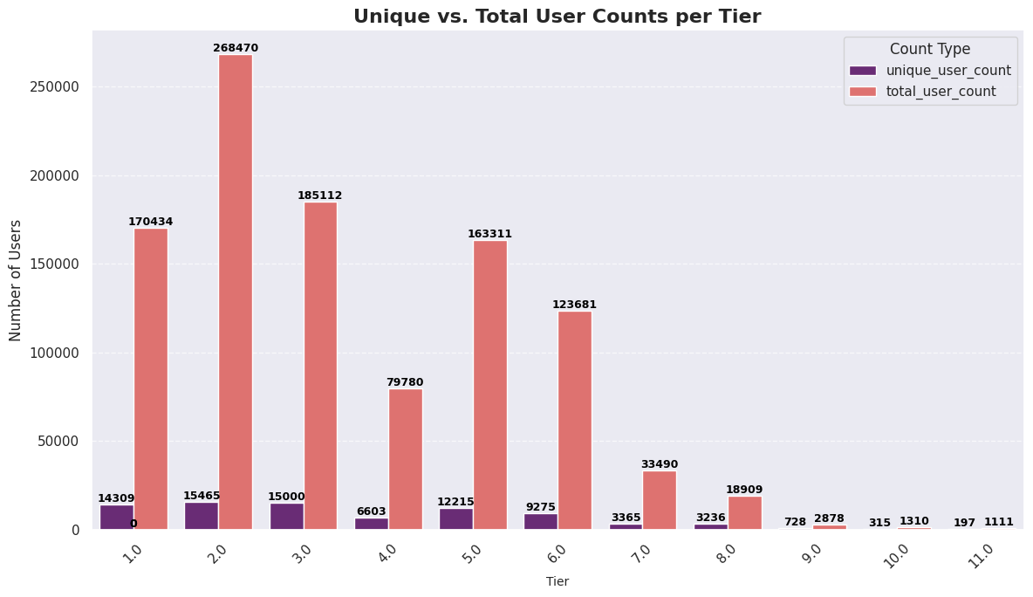
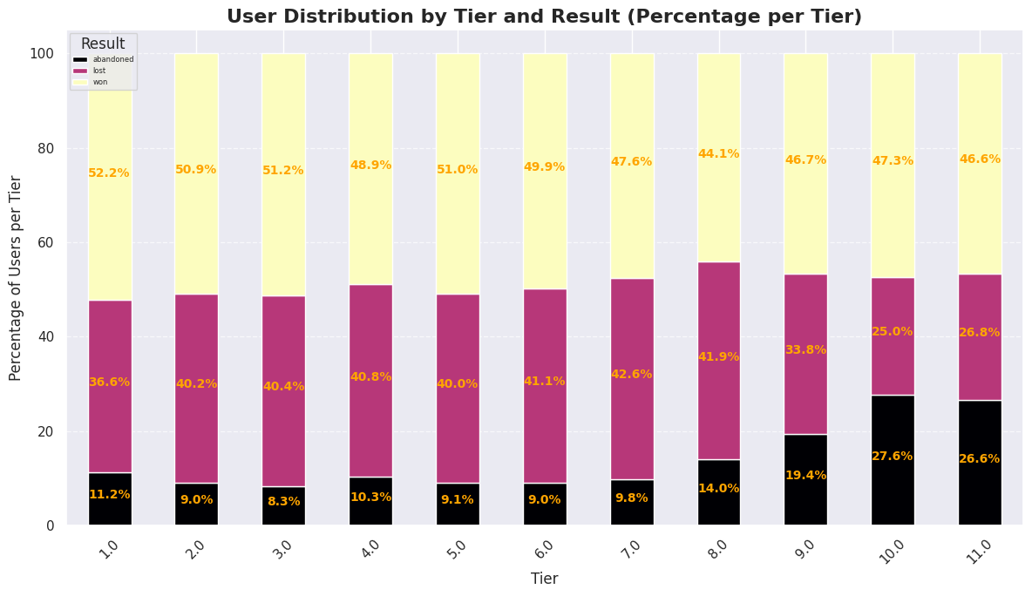
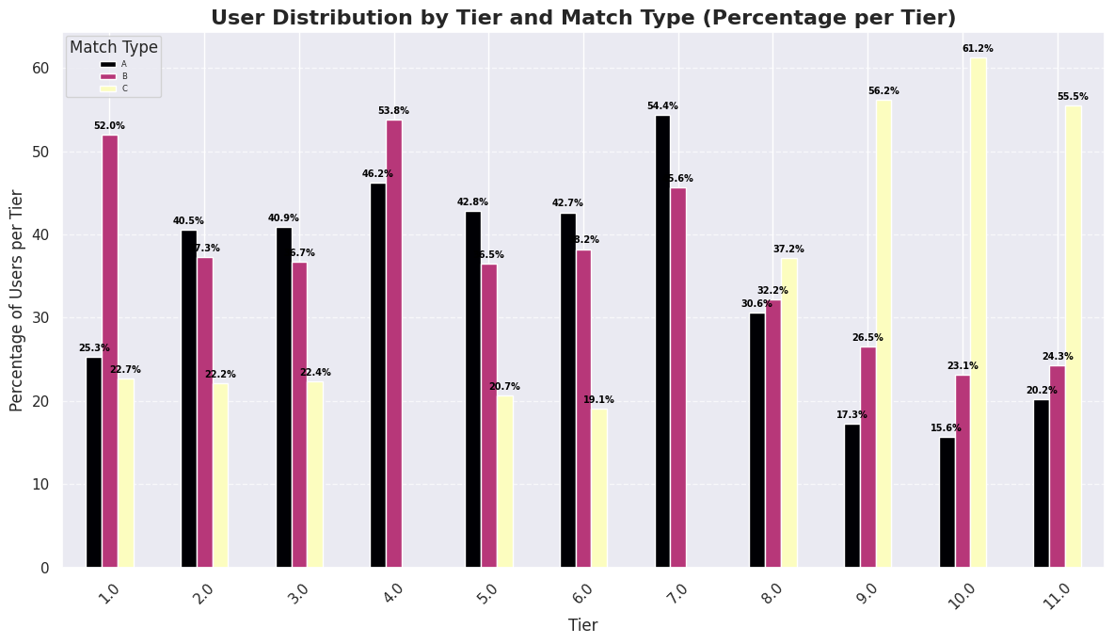
Tier Engagement Progression
Engagement across tiers peaks at Tier 2, which represents the core gameplay zone with the highest user activity and strong participation across match types, particularly A and B.
A clear bottleneck appears at Tier 4, where overall engagement drops. At this point, Type C disappears entirely (0 users) and Type B also declines, suggesting a progression or balance issue that limits access or appeal at this stage.
There is a secondary rebound at Tier 5, where engagement recovers across all available match types, indicating that users who pass Tier 4 tend to re-stabilise and continue engaging.
From Tier 6 onwards, engagement steadily declines as expected, but quality signals weaken. Abandon rates rise sharply in higher tiers, reaching ~26.6% by Tier 11, showing increasing fatigue or frustration among advanced players.
Overall, the feature shows strong early engagement at Tier 2, a major friction point at Tier 4 (especially impacting Type C) and a long-term challenge in sustaining engagement among higher-tier users.

Slide 8
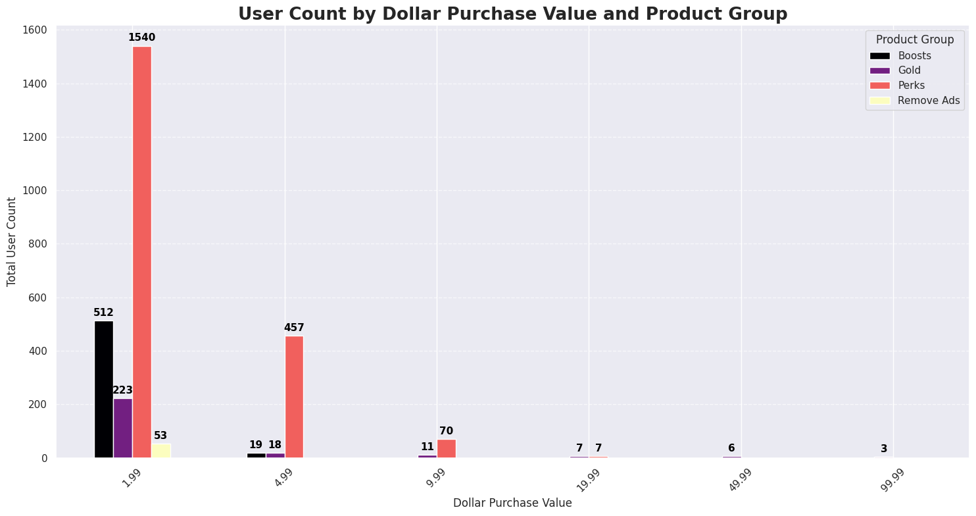
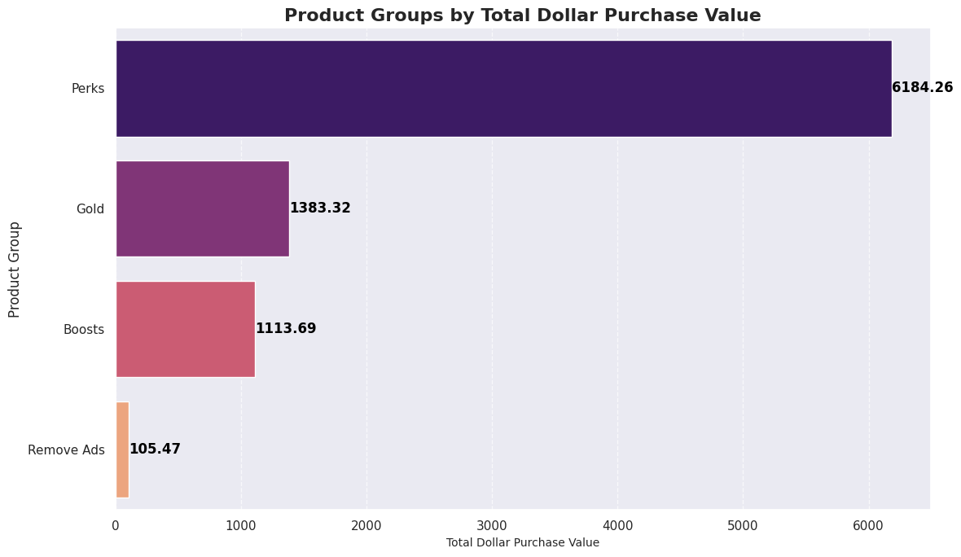
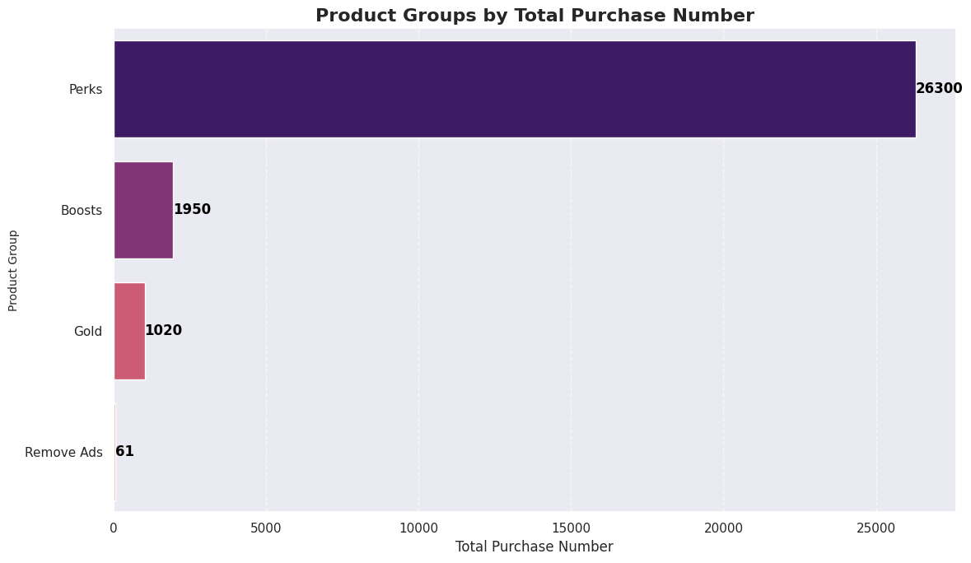
In-App Purchases (Monetization)
Monetisation is strongly driven by low-value, high-volume purchases. Perks dominate performance, generating ~6.2K revenue from 26.3K transactions, with the $1.99 price point clearly acting as the main conversion driver.
Gold performs as a mid-tier monetizer, contributing ~1.4K revenue from a smaller but higher-intent user base, while Boosts generate ~1.1K revenue but remain heavily skewed toward the lowest price point, showing strong usage but limited upsell depth.
In contrast, Remove Ads is severely underperforming, with only 53 purchasers and ~105 revenue despite broad ad exposure, indicating a major conversion or value perception gap.
Overall, monetisation is heavily concentrated in low-price purchases, with strong volume but weak progression into higher-value tiers; highlighting an opportunity to improve mid-to-high tier conversion and fix Remove Ads adoption.

Slide 9
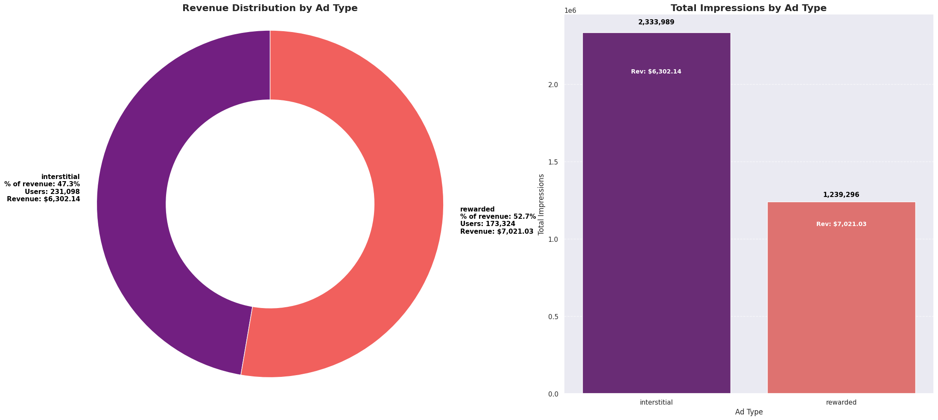
AD Revenue (Monetization)
Ad monetisation is being driven more efficiently by rewarded ads than interstitials, despite lower reach and impressions. Interstitial ads serve a larger audience (231K users) and generate significantly more impressions (2.33M vs 1.24M), but still contribute less revenue at $6.3K.
In contrast, rewarded ads serve fewer users (173K) and fewer impressions, yet generate $7.0K in revenue—about 11% more than interstitials, and account for 52.7% of total ad revenue despite only ~35% of impressions per user share. This indicates a much higher value per impression and stronger user engagement when users opt in.
Overall, rewarded ads are materially more efficient, delivering higher monetisation density and better user-value alignment, while interstitials appear over-served relative to their revenue contribution, suggesting potential user experience drag without proportional financial return.

Slide 10
TapSlam: Game Design Recommendations
1. Fix the Tier 4 Bottleneck
• Tier 4 is a structural drop-off — user counts plunge and Types B & C are absent
• Investigate gating rules: is difficulty spiking unfairly or is progression unclear?
• Introduce a catch-up mechanic or tutorial boost to ease the Tier 3-4 transition
• Consider a temporary bonus reward for first Tier 4 completion to re-motivate stalled players
2. Rebalance Match Type C
• Type C has 48% fewer daily users than B and the highest abandon rate (11.2%)
• High mid-match abandonment signals engagement or fairness issues — not just difficulty
• Redesign or better surface Type C's unique value proposition at the mode selection screen
• A/B test a match length reduction or score visibility change to reduce mid-match drop-off
3. Swap Interstitials for Rewarded Ads
• Rewarded ads earn 11% more revenue on 47% fewer impressions — far higher CPM
• 2.33M interstitial impressions risk player frustration and churn with inferior yield
• Reduce interstitial frequency by 30-50%; replace with opt-in rewarded placements
• Trigger rewarded ads at high-value moments: after close losses, tier completions, or daily login
4. Convert Ad-Tolerant Users with a Smarter Remove Ads Offer
• Only 61 of 231K interstitial-exposed users paid to remove ads — a conversion rate of <0.03%
• Current Remove Ads pricing or placement is failing to convert at scale
• Deploy a contextual offer after 3+ consecutive interstitial sessions or post-loss moments
• Test a time-limited discount (e.g. 50% off for 24hrs) to create urgency and lift conversion
5. Protect and Nurture Match Type A Retention
• Type A leads on 30-day retention at 48.2% despite lower adoption than B
• A retains better because it likely offers a more balanced or rewarding experience
• Study what distinguishes Type A’s loop and apply learnings to Type B (higher volume, lower retention)
• Feature Type A more prominently in onboarding to seed long-term retention from day 1
6. Build a Platform-Specific iOS Strategy
• iOS users are 20.5% of unique users but only 16% of sessions — less frequent but more diverse
• iOS users likely have higher spending power; IAP pricing should reflect this
• Test premium-tier Perks bundles or iOS-exclusive cosmetics to capture higher willingness to pay
• Ensure interstitial frequency is especially controlled on iOS to protect user quality

